Slide 1




PREDICTION OF POPULATION GROWTH AND AIDS INFECTION BASED ON US HEALTH STATS DATA
By Group – 34
ANIL KUMAR BENARJI
MANI CHAKRAVARTHI
KAVYA PENUJURU

Slide 2

AGENDA
Project Design and Architecture
Team Collaboration
Division of work
Data Preparation
Feature Extraction
Data Visualization
Modeling and Evaluation
Conclusion

Slide 3
Problem Statement
Health Stats provides key health, nutrition and population statistics gathered from a variety of international sources. Themes include population dynamics, nutrition, reproductive health, health financing, medical resources and usage, immunization, infectious diseases, HIV/AIDS, DALY, population projections and lending. Health Stats also includes health, nutrition and population statistics by wealth quintiles.
Create clusters of countries based on indicators and predict
Population growth
AIDS related deaths

Slide 4
Data understanding
Time series data
Wide data – Where feature grouping was missing
-- Have transposed data
-- It is easier to read and interpret as compared to wide format
Identified target variables as AIDS estimated deaths (UNAIDS estimates) - SH.DYN.AIDS.DH, SP.POP.GROW
Observed that there is no data till 1990 for the target attribute and the same data is missing for some countries
Data quality is adequate

Slide 5
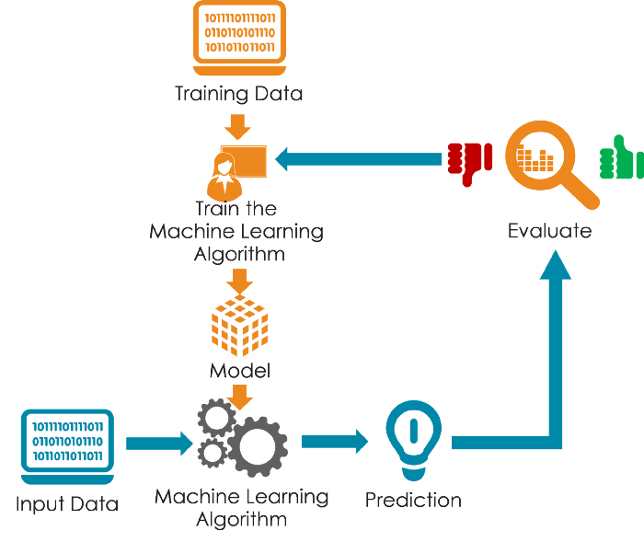

Slide 6
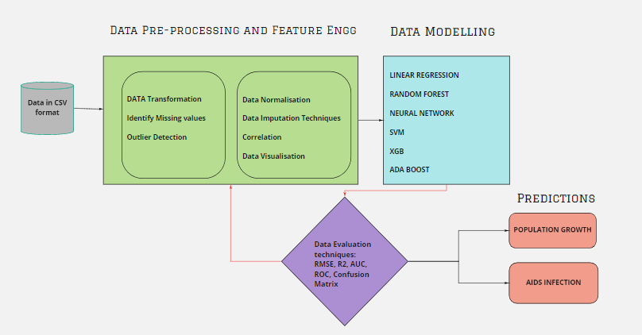
PROJECT ARCHITECTURE PLAN

Slide 7
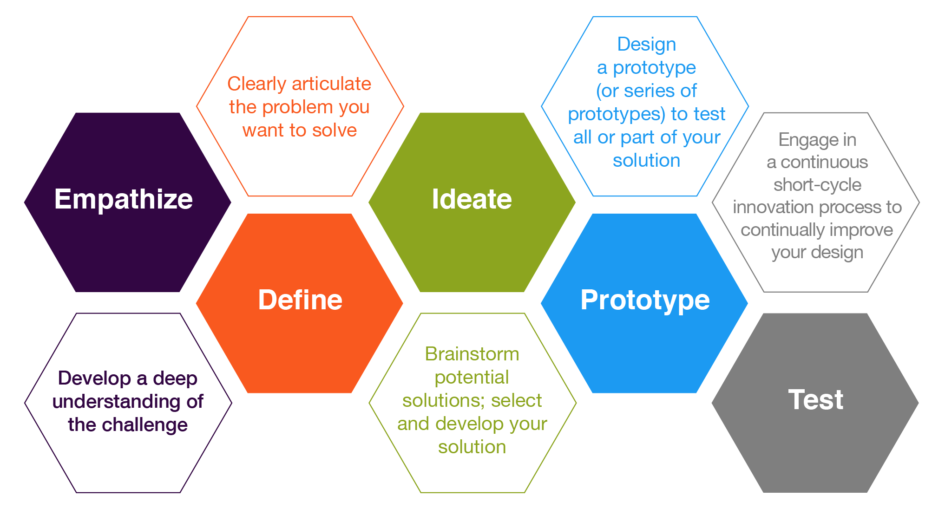

Slide 8
ANIL
Data Preparation
Data Visualization like Jitter Plot, Box Plot
MANI
Data Preparation
Correlation among variables
KAVYA
Data Preparation
Data Visualization like Scatter plot, Bar graph, Histogram
Missing value imputation using KNN
Variability Predictors using Linear Regression
Outlier detection using single variate approach
Cook’s Distance research and development
Missing value imputation
Correlation among variables
Outlier detection
Research, implementation and evaluation of Linear Regression and Random Forest
Research, implementation and evaluation of Neural Networks and XGBOOST
Research, implementation and evaluation of SVM and AdaBoost

Slide 9
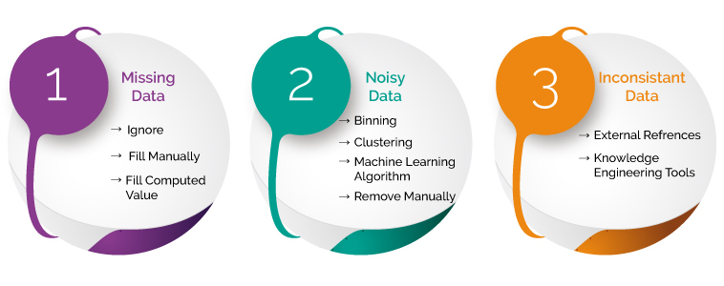
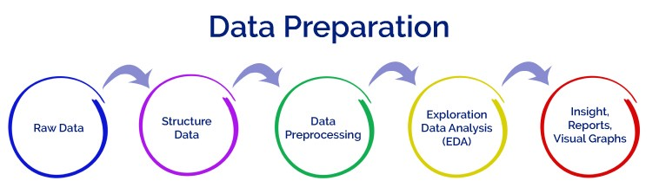
Data preparation
Identify missing data using missingno package
Normalized data using Minmax scalar
KNN Imputation
Outlier detection using DBSCAN algorithm

Slide 10
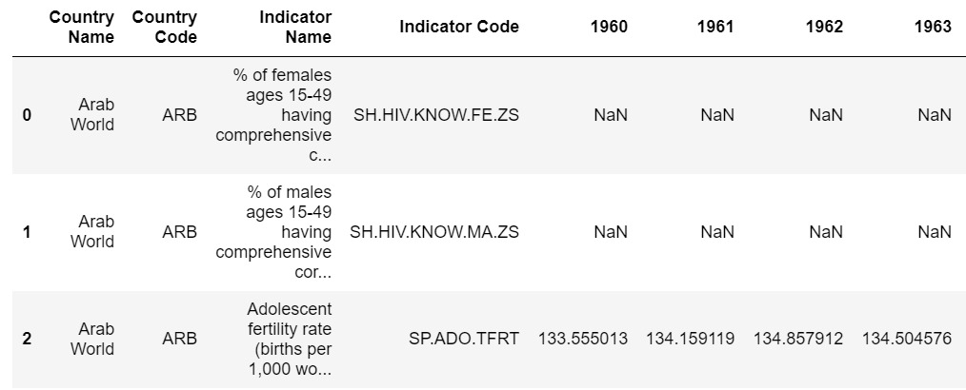
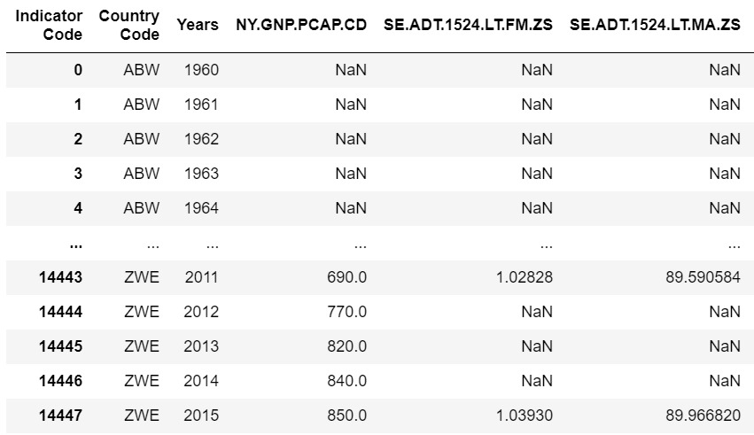
Data Transformation

Slide 11
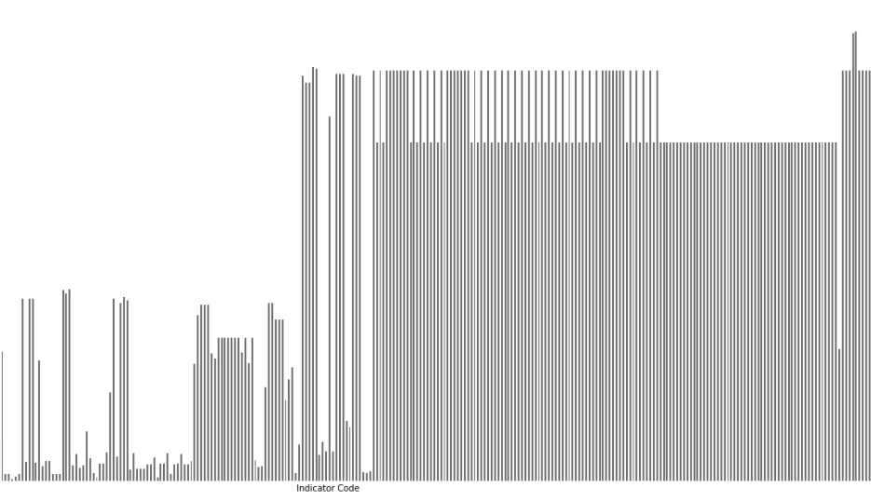
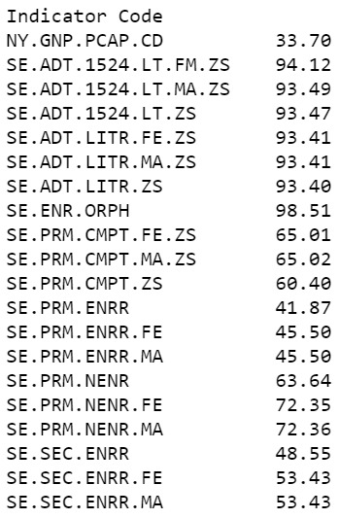
Missing values matrix
We have found there are many missing using Missingno package graph.
We have calculated the missing value percentage.
We used KNN approach to fill these missing values.

Slide 12
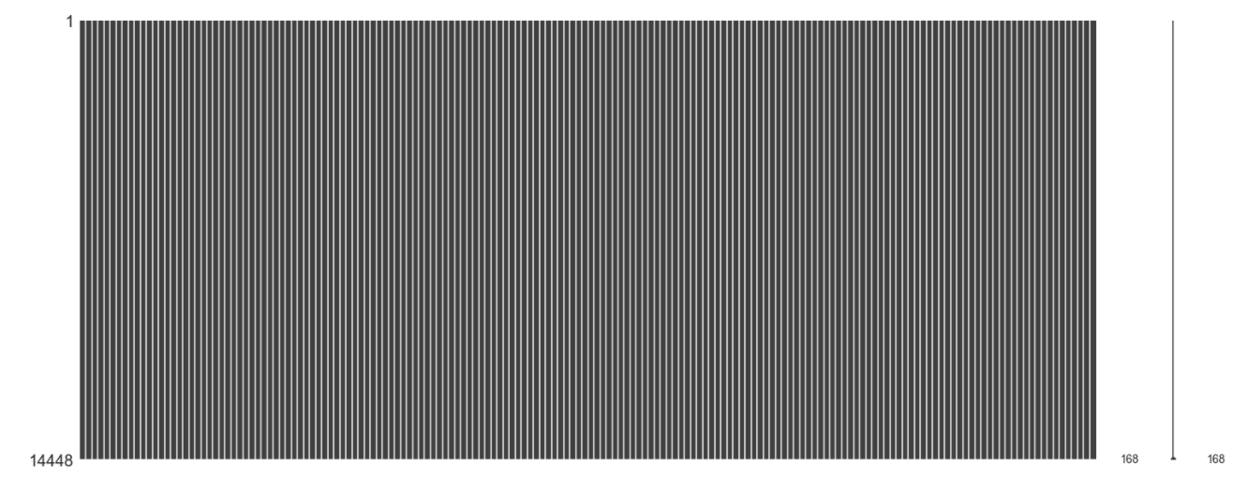
After KNN Imputation
After looking at missing value percentages, features which have >30% of missing data have been excluded
Normalization using Minmax scalar
KNN imputation with K value as 3 and 5
After looking at the frequency distribution, finalized with K=5 to impute the missing values.
Computed the missingno graph as shown here.

Slide 13
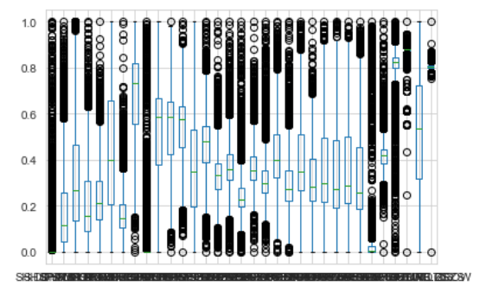
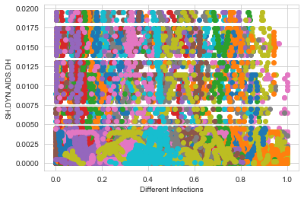
Outlier Detection
We have done 2 types of outlier detection:
Single variate: We used Z-Score to find the Standard Deviation of values. Then we excluded the data with SD > 2
Multi variate: We used DBSCAN to find the outliers. We have clustered the data using DBSCAN and find the cluster of values with -1 and excluded the same.
We used BOX plot to define our data and DBSCAN plots.

Slide 14
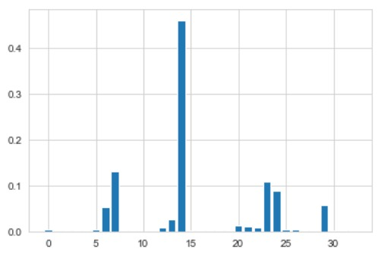
Feature Extraction
Absolute correlation matrix method.
We have reduced from 209 to 71 features after correlation method.
Linear regression-based feature importance.

Slide 15
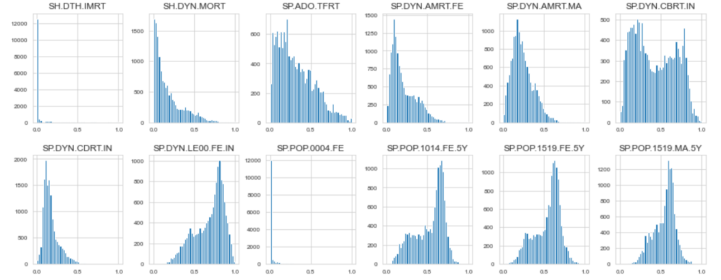
Frequency Distribution of Features

Slide 16
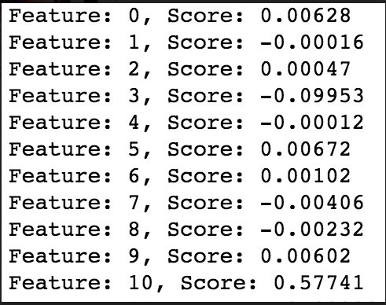
Feature Importance
Feature importance refers to techniques that assign a score to input features based on how useful they are at predicting a target variable.
We have chosen Linear Regression to find the scores of each variable.
Using Linear Regression algorithm, we find a set of coefficients to use in the weighted sum in order to make a prediction.
We will fit a model on the dataset to find the coefficients, then summarize the importance scores for each input feature and finally create a bar chart to get an idea of the relative importance of the features.
Here are the sample scores of each variable:

Slide 17
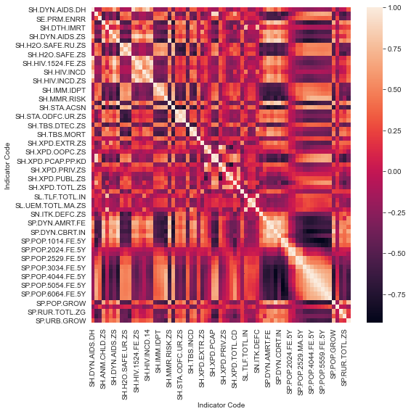
Correlation Matrix
Data correlation is the relationship between multiple variables and attributes in your dataset
Beside is the correlation matrix, where we can see the correlation is going from -1 to 1
If your dataset has perfectly positive or negative attributes, then there is a high chance that the performance of the model will be impacted by a problem called — “Multicollinearity”.
So, we remove the attributes, which are highly correlated, >95% (Absolute value)

Slide 18
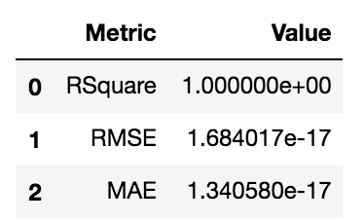
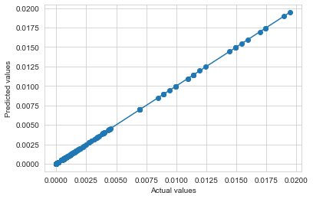
Linear Regression
Linear Regression is a technique used to predict the values based on independent variables.
For Multi Linear Regression, the dependent or target variable(Y) must be the continuous/real, but the predictor or independent variable may be of continuous or categorical form.
Each feature variable must model the linear relationship with the dependent variable.
MLR tries to fit a regression line through a multidimensional space of data-points.

Slide 19
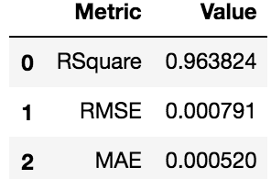
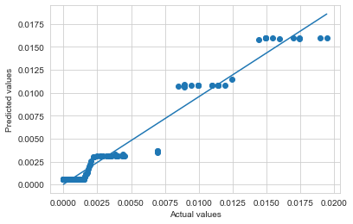
Random Forest
Splits the features into different trees based on sampling input
Provides quality of each split
Ensembles all the decision trees by averaging of predictive accuracy
Controls over-fitting
Metrics:

Slide 20
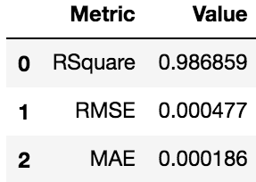
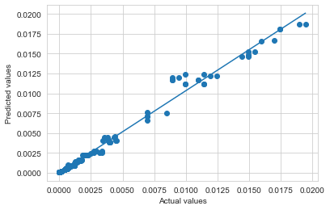
XG Boost
XGBoost is an optimized distributed gradient boosting library designed to be highly efficient, flexible and portable
It implements machine learning algorithms under Gradient Boosting Framework

Slide 21
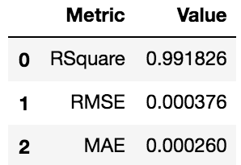
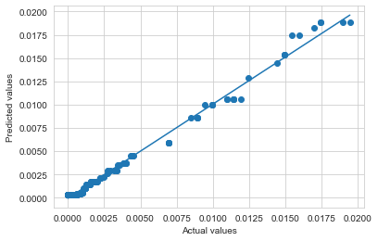
Ada Boost
The weak learners in AdaBoost are decision trees with a single split, called decision stumps.
AdaBoost works by putting more weight on difficult to predict instances and less on those already handled well.
AdaBoost algorithms can be used for both classification and regression problem.

Slide 22
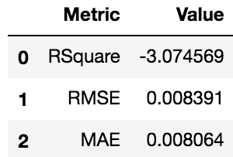
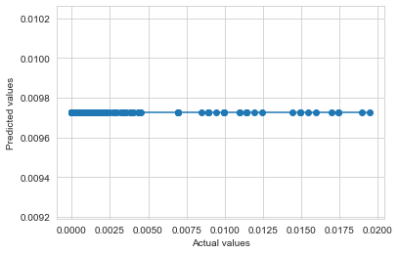
Support Vector Regression
Support Vector Machines (SVMs) are well known in classification problems. The use of SVMs in regression are called as Support Vector Regression.
SVR gives us the flexibility to define how much error is acceptable in our model and will find an appropriate line (or hyperplane in higher dimensions) to fit the data.

Slide 23
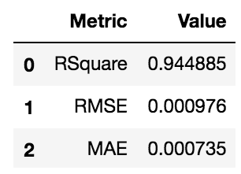
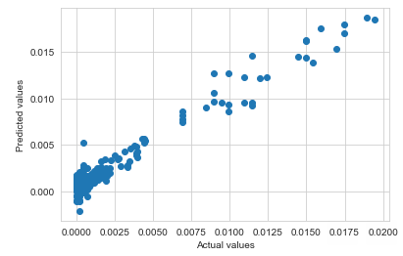
LSTM – Neural Networks
LSTM can by default retain the information for long period of time.
It is used for processing, predicting and classifying based on time series data.
Learns from the series of past observations to predict the next value in the sequence

Slide 24
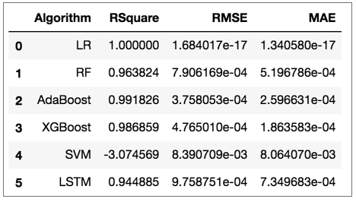
Conclusion
From the table Linear Regression and SVM are either overfitting or underfitting even after hyper parameter tuning.
LSTM, Random Forest, AdaBoost and XGBoost gave stable results, have got good R2 value as well as reduced Root Mean Square Error
But we see that AdaBoost has performed well and is the best suit for prediction of AIDS Infections/Deaths

Slide 25
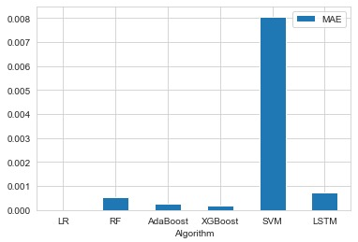
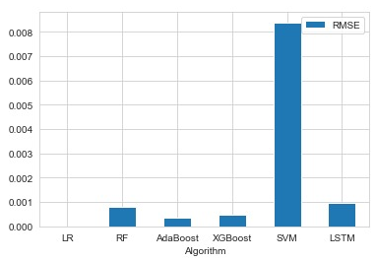
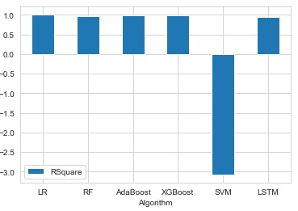
MOdel performance visualizations AIDS Infections/deaths

Slide 26
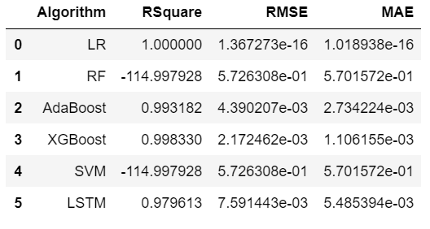
Conclusion
From the table Random Forest and SVM are either overfitting or underfitting even after hyper parameter tuning.
Linear Regression, LSTM, AdaBoost and XGBoost gave stable results, have got good R2 value as well as reduced Root Mean Square Error
But we see that XGBoost has performed well and is the best suit for Population Growth.

Slide 27
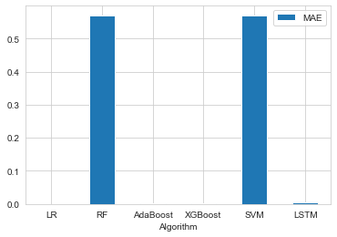
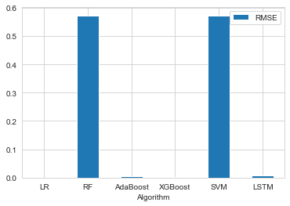
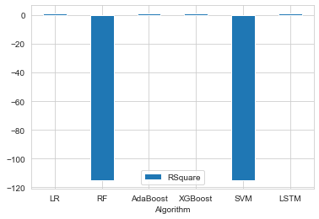
MOdel performance visualizations Population Growth

Slide 28

This Photo by Unknown Author is licensed under CC BY-SA

Slide 29

This Photo by Unknown Author is licensed under CC BY-SA

